Slide 1
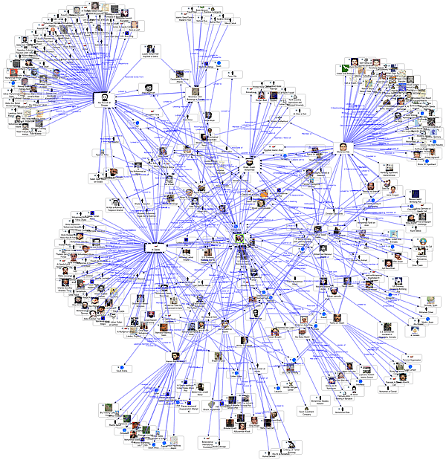

Coterie Identification in Facebook Network
A Comparative Study on -
Done and Presented by -
Tarun Kumar Ravipati
Bhavya Induri

Slide 2
Introduction
Data Set Collection and preprocessing
Implementation
LPA(Label Propagation)
Fast Unfolding Algorithm
Spectral Clustering
Advantages and Disadvantages
Validation
Results
Conclusion
Future Work
CONTENTS

Slide 3
Introduction
Coterie - Peers / Community / Fraternity / Band
Coterie Identification is basically “Community Detection”
What is a Community?
Group of people sharing the common interest, coming together
What is a Community in Facebook Network?
You and Me like a similar picture - Matches our interest
We fall into the community of people that has one specific interest

Slide 4
Introduction(2)
To put this in technical terms -
A community is a subgraph containing nodes which are more densely linked to each other than to the rest of the graph
(OR)
A graph has a community structure if the number of links into any subgraph is higher than the number of links between those subgraphs i.e it is the sub-network in a network which are highly interconnected nodes.
Given a network diagram, the process of finding its community structure is called community detection

Slide 5
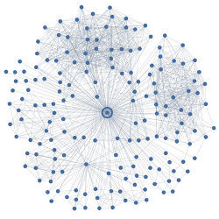
Introduction(3)
This project is a comparative study of three algorithms that can effectively be used for community detection in the large networks such as Facebook for instance.
Label Propagation Algorithm
Fast Unfolding Algorithm
Spectral Clustering Algorithm
Facebook data edge representation(of nodes)
* Each dot corresponds to a user in the network

Slide 6
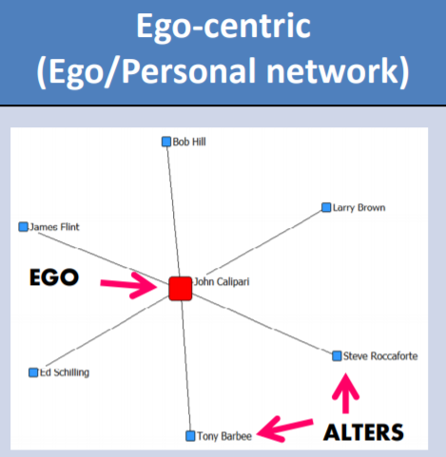
Dataset
Dataset Name: Facebook Data
This dataset consists of –
1. NodeID Edges - for the node “NodeID”
2. NodeID Circles - The set of circles for the ego node
3. NodeID Features - Profile information
4. Ego Network Features - Features of Ego User
5. NodeID Feature Names - Names of feature dimensions
(anonymized) Feature = 1: Property is in profile
Feature - 0: Property is absent
Edges are undirected in the network.
NodeID Features Names File has been anonymized for
facebook users, since the names of the features would
reveal private data.

Slide 7
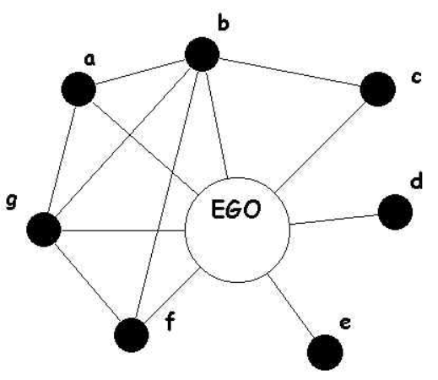
Dataset Statistics
Pre-Processing:
Inconsistencies are identified
Obtain the missing edges between nodes
Standard Graph Generation
Principal Component Analysis
Correlation of Nodes
Nodes – 4039
Edges – 88234
Nodes in largest WCC – 4039 (1.000)
Edges in largest WCC – 88234 (1.000)
Nodes in largest SCC – 4039 (1.000)
Edges in largest SCC – 88234 (1.000)
Average Clustering coefficient – 0.6055
Number of Triangles – 1612010
Fraction of closed triangles – 0.2647
Diameter(longest shortest path) – 8
90-percentile effective diameter – 4.7

Slide 8
Implementation
1. Label Propagation Algorithm
Def: Label Propagation is a semi-supervised machine learning algorithm that assigns labels to previously unlabeled data points
At the start of the algorithm, a (generally small) subset of the data points have labels (or classifications). LPA is to transfer label information constantly between nodes.
These labels are propagated to the unlabeled points throughout the course of the algorithm
Keywords - Node Importance
Label Influence

Slide 9

Implementation(2)
Node Importance:
Bayesian network property algorithm is used - Probability of importance
Steps:
Obtain user’s basic interests(based in likes, comments, shares,..etc)
Calculate Cumulative no.of interests relating to other users
The user with most interests is labelled as Important User
Concurrent steps for Label Influence -
Calculate the total user influence through multiplying the influence of each attribute factor. The formula is as follows -
Where P(Inf) = Influence of the user(ego node)
P(Inf | Attr) = Influence of each attribute of the user(ego node)
Normalize the influence of all the users in the dataset, and the importance of each node is obtained.

Slide 10
Implementation(3)
LPA Overview:
Every node is initialized with a unique label, then the labels diffuse through the network.
Consequently, densely connected groups reach a common label quickly.
When many such dense (consensus) groups are created throughout the network, they continue to expand outwards until it is impossible to do so.

Slide 11
Implementation(4)
LP Algorithm:
Step - 1: Initialize the labels at all nodes in the network. For a given node x, C_{x} (0) = x.
Step - 2: Set t = 1. (where t is the number of the iteration)
Step - 3: Arrange the nodes in the network in a random order and set it to X.
Step - 4: For each x ∈ X chosen in that specific order, let C_{x}(t) = f(C_{xi1}(t), ...,C_{xim}(t),C_{xi(m+1)} (t − 1), ...,C_{xik} (t − 1)). f here returns the label occurring with the highest frequency among neighbours. Select a label at random if there are multiple highest frequency labels.
Step - 5: If every node has a label that the maximum number of their neighbours have, then stop the algorithm. Else, set t = t + 1 and go to (3)

Slide 12
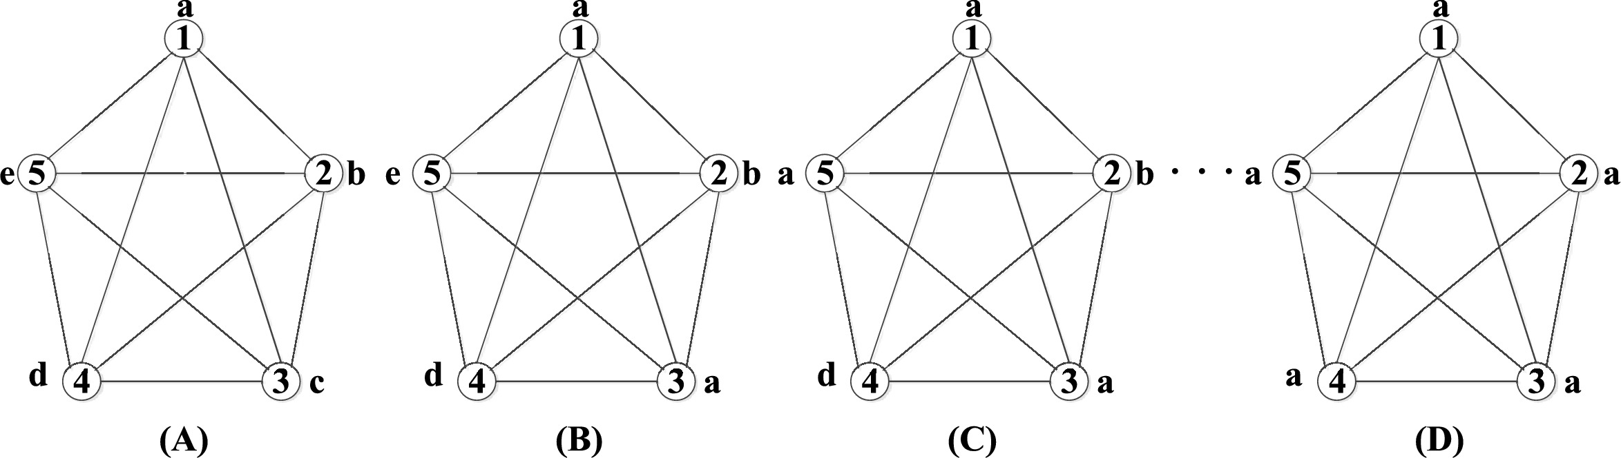
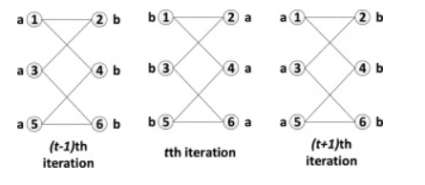
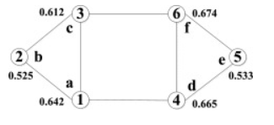
Implementation(5)
Th
After identifying the important nodes and ordering them, LPA is done as follows -
Label Updation Methods:
Synchronous Updation
Asynchronous Updation
Oscillation phenomenon
Uncertainty

Slide 13
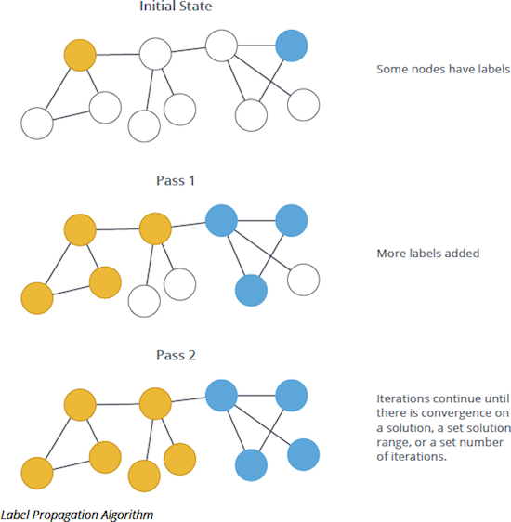
Implementation(6)
Next iteration, t = t + 1

Slide 14
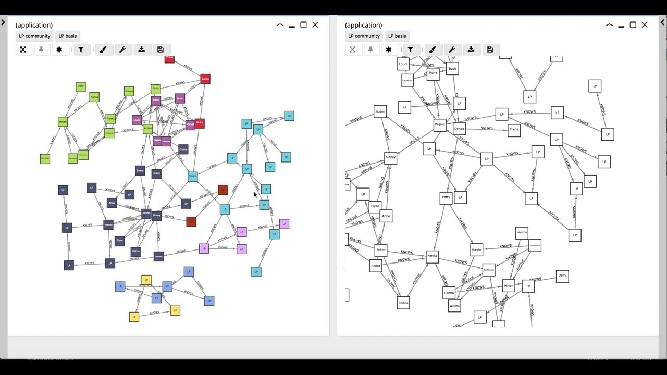
To Sum Up -

Slide 15
Implementation(7)
2. Fast Unfolding Algorithm
This algorithm is done in two phases -
Identifying Communities
Merging these communities into a single community
Phase - 1:
1. Assign a different community to each node in a network
2. Then for each node i consider node j and evaluate gain in modularity by removing node i from its community and placing it in community of j
3. The node i is placed in the community for which it gains max modularity, but gain should be +ve. If -ve we do nothing.
4. The process is applied continuously until no further improvement can be achieved.
5. This completed the phase 1

Slide 16
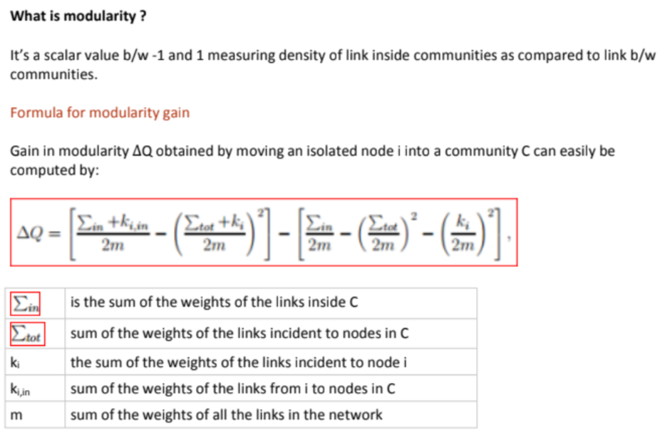
Implementation(8)
The phase-1 of this algorithm is based on modularity optimization.

Slide 17
Implementation(9)
Phase - 2:
Here we build nodes by merging all the nodes in community as a single node.
Weights of the link between the nodes is given by, sum of the weights of the links between nodes in corresponding two communities.
Links network nodes, of same community lead to self-loops for this community in the new network.
Repeat Phase 2 until no improvement can be made.

Slide 18
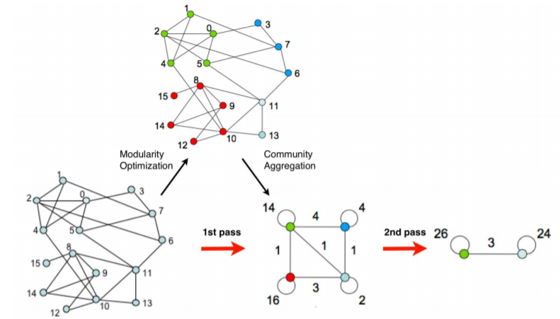
To sum-up:
For community-1:
0 2, 4, 5
1 2, 4
2 1, 0, 5, 4
4 2, 1, 0
5 0, 2
Total links within the community = 14

Slide 19
Implementation(10)
3. Spectral Clustering
Spectral clustering has become increasingly popular due to its simple implementation and promising performance in many graph-based clustering. It can be solved efficiently by standard linear algebra software, and very often outperforms traditional algorithms such as the k-means algorithm.
To perform a spectral clustering we need 3 main steps:
Create a similarity graph between our N objects to cluster.
Compute the first k eigenvectors of its Laplacian matrix to define a feature vector for each object.
Run k-means on these features to separate objects into k classes.

Slide 20
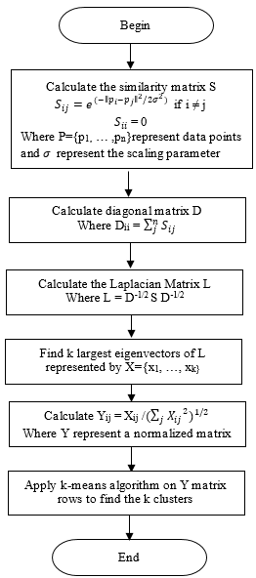
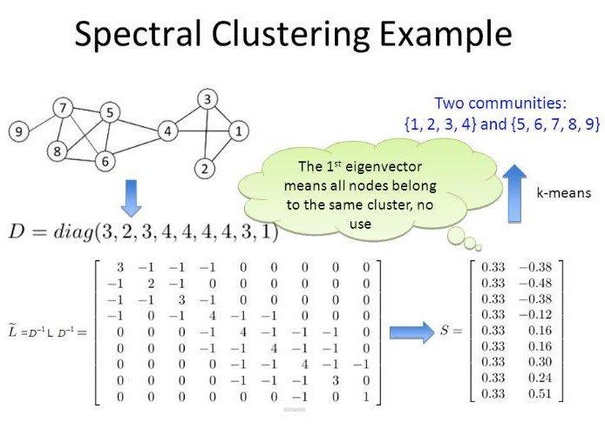
General Spectral Clustering Scenario -
Algorithm

Slide 21
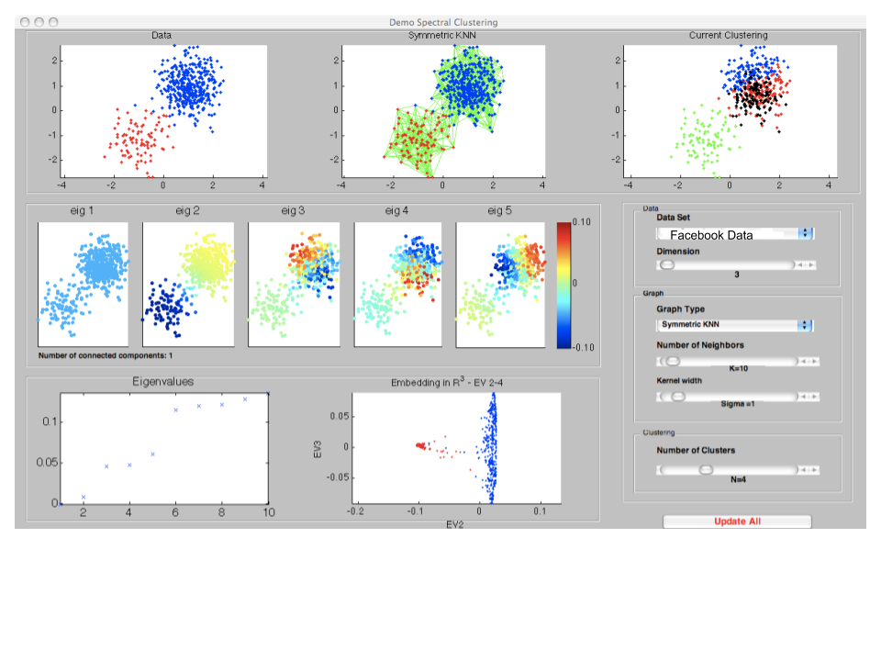
To Sum Up -

Slide 22
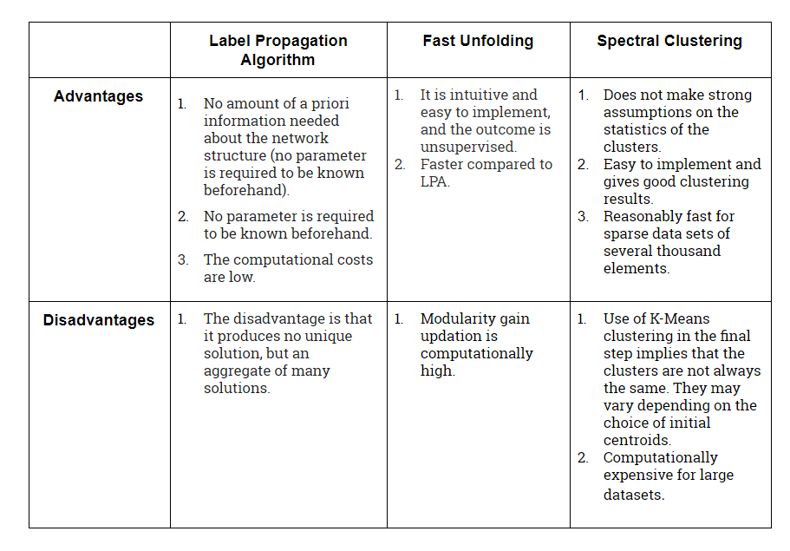
Advantages and Disadvantages

Slide 23
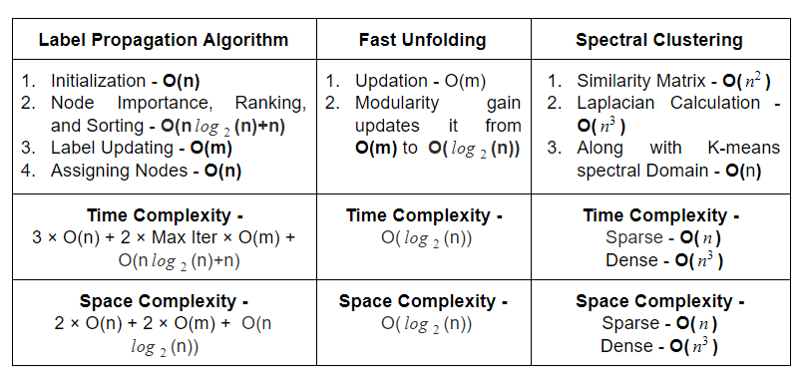
Validation
Every method needs metrics to validate it’s liabilities and it’s gains in the context of a system. In order to evaluate the efficiency of these algorithms, we consider common parameters for validation. We have considered -
Time Complexity and
Space Complexity

Slide 24
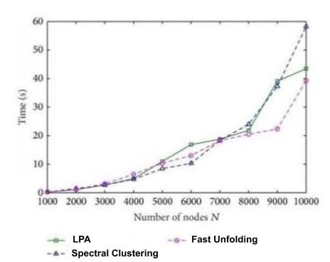
Results
We compare the complexities owing to the three algorithms and plot them to a scale by varying the no.of elements in the dataset and hence we can successfully compare which algorithm has the highest efficiency.
X - axis: No.of Nodes in the Dataset
Y - axis: Time taken to successfully identify the groups
Or peers in the Dataset Nodes

Slide 25
Conclusion
From the graph, we can infer that -
For larger Datasets,
The Fast Unfolding algorithm is computationally more reliable because the computational costs are very less.
Following this, Label Propagation is not far behind but has more computational time compared to Fast Unfolding.
The method with highest complexity is Spectral Clustering, because the complexity to find the inverse in the Laplacian matrix is in the cubical powers of n in dense networks.
Hence on Comparison, we declare that with respect to the Computational Efficiency, Fast Unfolding is the most efficient algorithm to detect the peers/communities/coterie in the Facebook Dataset that we have considered.

Slide 26


